Slide 1
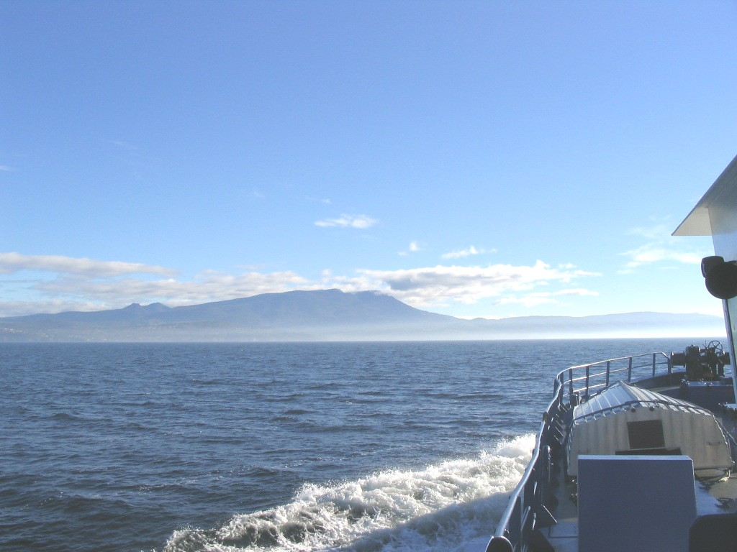
New Assessment techniques for small-scale fisheries
November 2012
Dr Jeremy Prince
Adj. Assoc. Prof.
Murdoch University
Western Australia
Acknowledgements:
David and Lucile Packard Foundation
The Nature Conservancy
Notes:
Thank you for this opportunity to tell you about the exciting new technique for assessing small scale and data-poor fisheries that I have been developing with colleagues over the last 3 years.
In this talk I want to tell you about a new cheap size based technique for generically assessing most fished stock that I am trialing around the world in projects for The Nature Conservancy, the David & Lucille Packard Foundation and the Marine Stewardship Council. I am calling this new approach SPR @ Size assessment.
We are hoping that this technique will become a new global standard for small-scale and data-poor fisheries assessment.
In Palau and California I am working The Nature Conservancy through their fisheries global priority which in part will focus on extend this technique around the Pacific Rim

Slide 2
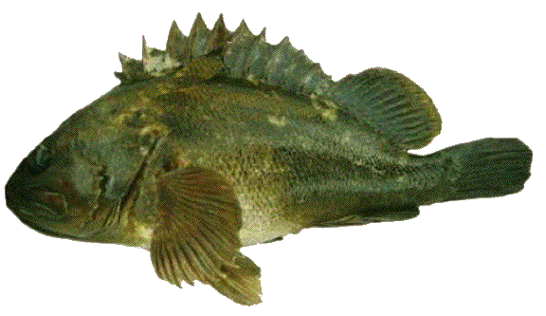
Frequency
Size
FISHING EFFORT = 0
Notes:
Let me start by illustrating how fishing changes the size composition of a stock.
This graph shows a size-frequency of an unfished stock.
The bottom axis shows the size categories from small fish on the left to big fish on the right. The left hand axis shows how many fish or shellfish are in each size category.
Generally there are relatively few very small animals in a size sample because most fishing techniques select against catching the very small fish.
There are also few very big fish because few individuals survive to reach the biggest size classes.
In a lightly fished stock most of the fish are middle sized,
With the next slide we start to see what happens when fishing begins on the fish stock.

Slide 3
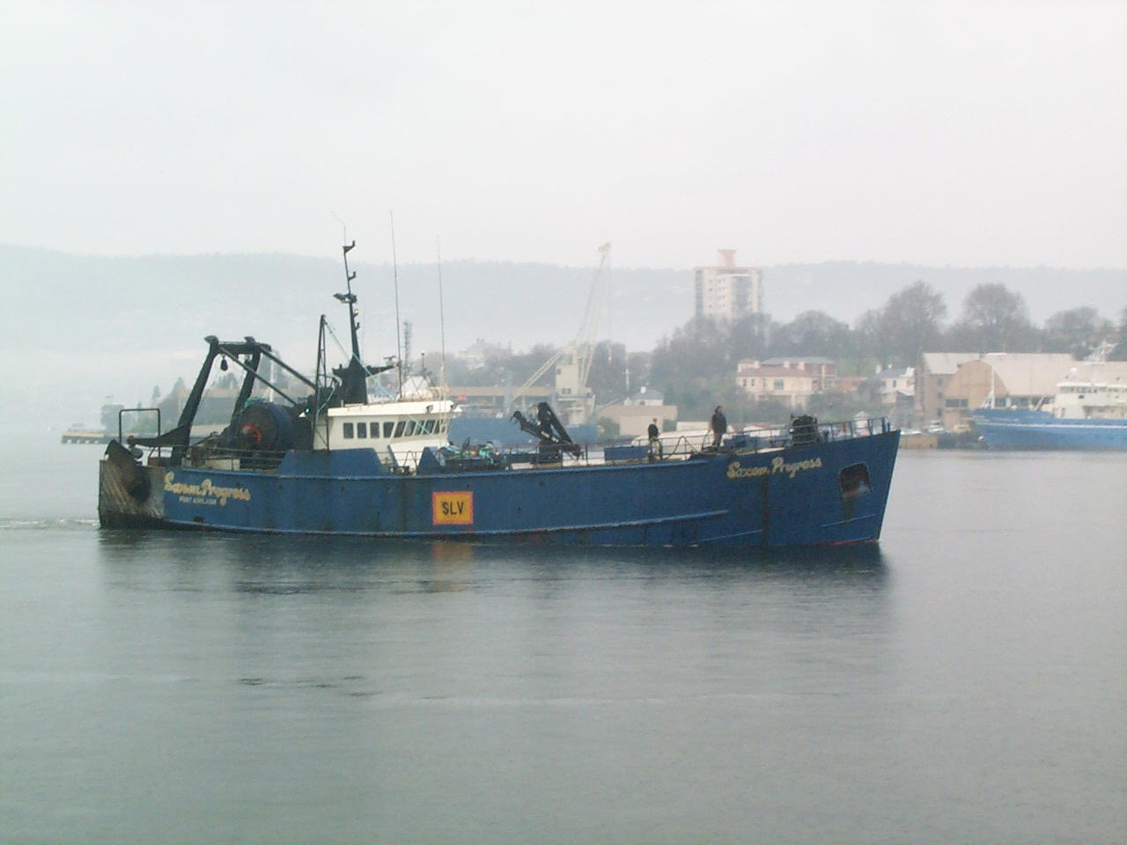
Frequency
Size
FISHING EFFORT
Notes:
In this slide we see what happens with a small amount of fishing –indicated here by one boat.
With the red curve now falling below the black curve we see that fishing at first reduces the abundance of the biggest animals first.
In these slides the original unfished size structure of the stock from the slide before will be shown by the black outline.
With the next slide we see how increasing fishing effort gradually eats away the size composition from the right hand or big fish side of this graph.

Slide 4
Frequency
Size
FISHING EFFORT
Notes:
As the fishery continues to grow and fishing effort increases, the number or frequency of the biggest fish falls to very low levels, although at first there are still plenty of middle sized fish left in the stock.

Slide 5
Frequency
Size
FISHING EFFORT
Notes:
As effort in the fishery continues to grow the number of the middle size fish also starts to decline.

Slide 6
Frequency
Size
FISHING EFFORT
Notes:
With heavy fishing pressure – the small fish have become the most common size categories in the stock and we no longer see the biggest size classes of fish.
No animals survive fishing long enough to reach the maximum size. While there are enough adult animals the number of little fish – recruitment – will remain stable.
However if fishing effort keeps growing, eventually the rate of recruitment will also fall, reducing the number of small fish in the stock as well.

Slide 7
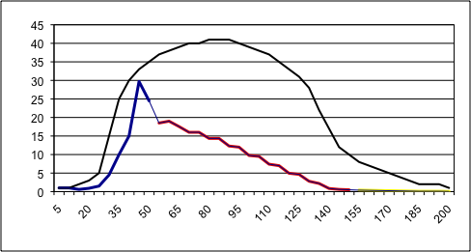
Frequency
Size
FISHING EFFORT
Notes:
Eventually with heavy fishing pressure recruitment will decline and the size composition will eroded from both the left and right hand sides.

Slide 8
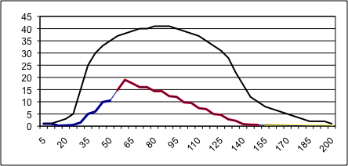
Frequency
Size
FISHING EFFORT
Notes:
As recruitment declines the amount of fish in the stock will start falling rapidly.

Slide 9
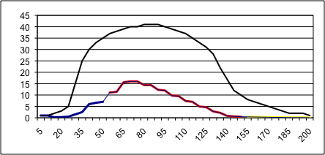
Frequency
Size
FISHING EFFORT
Notes:
And the same number of fishermen and fishing boats will be caught fishing harder for less and less fish.

Slide 10
How Much Spawning is Enough?
Frequency
Size
FISHING EFFORT
Notes:
So the question for stock assessment is:
How much spawning is enough? What is enough to avoid recruitment declining and to sustain productivity?
The problem in stock assessment has been that a lot of biological studies and modeling has been required.
Studies that require many years, great expense and high levels of scientific expertise for each stock.
This is where our new SPR @ Size assessment technique helps.
In stock assessment the amount of spawning is generally measured in absolute terms as an amount of biomass; in surveyed tonnes or as a percent of the original biomass. But it can also be measured as a rate of spawning, the proportion of the spawning that have would occurred if there were no fishing.
What we fisheries scientists refer to as Spawning Per Recruit or SPR. Our approach estimates SPR from the size composition of fished stocks.
This approach makes stock assessment much less data intensive than existing assessment techiques.

Slide 11








Human Populations
More than 2 Children per couple
Population
Growth
2 Children per couple
Population Stable
Replacement Level
Less than 2 Children per couple
Population
Decline
Notes:
Let me illustrate the concept of Spawning Per Recruit or SPR with the human example
It is common knowledge that if human populations produce on average 1 child for every adult; that is 2 children / couple then a population will stabliize. This is called the ‘Replacement Level’ because the population simply replaces itself..
In fact for humans the replacement level 2.1 children per couple, the extra 0.1 child makes up for adults who do not become parents. However I do not care for a slide showing 2.1 children per couple.
If on average there are more children per couple the population will have a tendency to grow towards whatever limits to growth exist, and if this human ‘SPR’ is lower than 2 children per couple, then the population will decline.

Slide 12







Spawning Per Recruit (SPR)
Population
Growth
More than 30-50% SPR
20-25% SPR
Population Stable
Replacement Level
Less than 20% SPR
Population
Decline
Notes:
More normally we apply the concept of SPR to marine species.
If a species is not fished it produces 100% SPR, and fishing reduces the level of spawning completed by each recruit to the fishery.
Overfishing and recruitment declines occur when SPR is reduced below the Replacement Level.
Studies show that the replacement level for marine species tends to be around 20-25% of the unfished level of SPR.
Above 30% SPR populations have a capacity to grow back to carrying capacities, and below 20% SPR populations risk declining.
Our new technique makes it possible to estimate the level of SPR in a fish stock simply by studying the size composition of a population.
Previously complex biological studies and computer modeling has been required to make these sort of assessments, we have found that all the species exhibit similar patterns in the way they grow and develop SPR this makes simple generic size assessments possible.

Slide 13
How Much Spawning is Enough?
100% Spawning per Recruit (SPR)
Frequency
Size
FISHING EFFORT
Notes:
Returning to the question of: How much spawning is enough?
With our technique only three pieces of information are necessary to estimate SPR:
The unfished size structure which defines 100% SPR and which previously had to be estimated from size data collected before fishing began. With our breakthrough we can now estimate this size structure from general information about a species life history strategy, rather than detailed biological studies.
2. The current size structure of the stock which in many cases can be measured by sampling the catch
And …
3. An estimate of the size of maturity that can be derived by sampling each size category and determining the proportion that is mature or immature.

Slide 14
Spawning Per Recruit (SPR)
100% SPR
Frequency
Size
Size of Maturity
Notes:
These next slides illustrate how these three pieces of information are used.
The area under the adult portion of the unfished size distribution gives an estimate of 100% SPR. This is estimated from the SPR @ Size relationship for each species which I have found can be derived from general information about a species.
By comparing the area under the adult part of fished size distribution we derive SPR. It is the Size of Maturity that allows us to determine what is the adult part of these two size distribution curves.
So for example if we conduct a study that determines the size of maturity is around 40 units as in this figure, the area under the fished size distribution is about 35% of the adult unfished histogram so SPR of about 35%.

Slide 15
Current Spawning Per Recruit (SPR)
100% SPR
Frequency
Size
Size of Maturity
Notes:
On the other hand if the Size of Maturity is more like 85 units, then the area under the mature fished size distribution is about 20% of the unfished size distribution and SPR is just 20%.

Slide 16
100% SPR
Frequency
Size
Spawning Per Recruit (SPR)
Size of Maturity
Notes:
If SOM had been estimated to be 125 units the area under the curves suggest SPR is <10%.

Slide 17
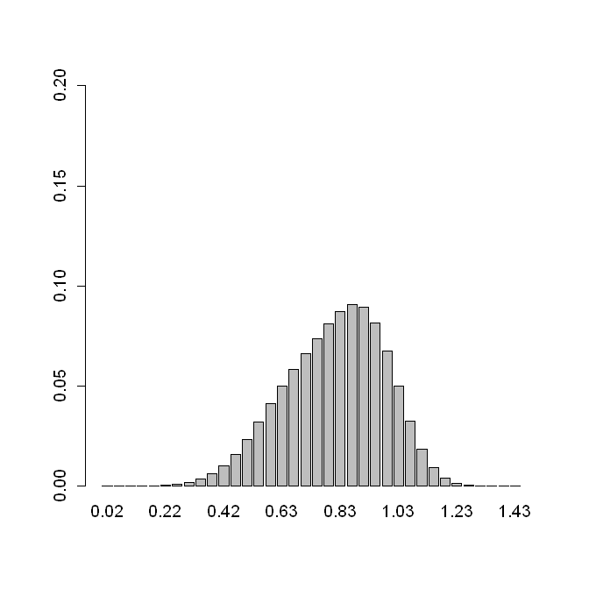
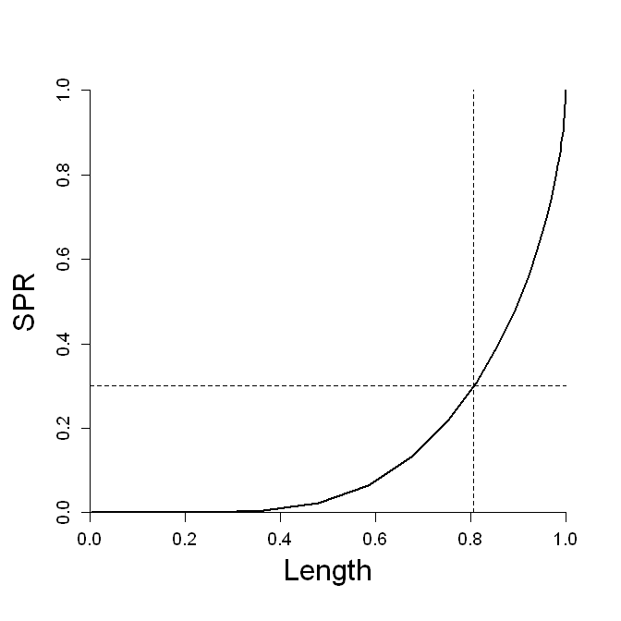

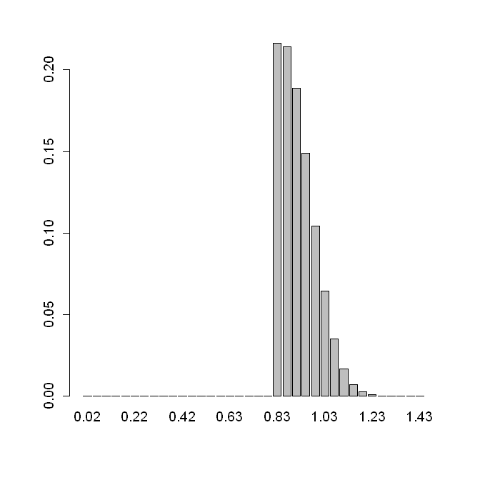
Adult Size Structure 100% SPR unfished
Unfished Reference Points
SPR @ Size Curve
Blacklip abalone
Size Targets for Size Unselective fisheries
50% SPR
All adults fished
Size Limits & Targets for Size Selective fisheries
DATA Needs
50% SPR
Adults >30% SPR fished
1. Local Size of Maturity
2. Adult Size Composition
Notes:
This SPR @ Size approach can be used to estimate a range of useful management reference points.
Here on the left we have the generalized SPR @ Size curve which is found in abalone and is typical of a mildly K-selected species, which have also been called equlibrium strategists, as opposed to r-selected or opportunistic species.
This generalized SPR @ Size curve can be used to estimate:
The Adult Size composition of the unfished population, which as just described can be used by comparison to estimate the current SPR of a stock
The Size distribution expected at some target level of spawning – here 50% SPR
Size limits to conserve target levels of SPR – here the size limit that protects 30% SPR, and the target size composition that preserves a further 20% of spawning above the size limit.
These types of size targets open the way for cheap Harvest Strategies that use the SPR based size target as the basis for Harvest Control Rules that iteratively adjust catches and fishing effort until the size structure of the stock shows that fishing is balanced with maintaining the target level of SPR.
Such Harvest Control Rule are very simple. The size composition of each reef is compared to the SPR size target; catches are increased when the SPR target is exceeded, decreased when the population’s size composition is smaller than the SPR target, and held steady when around the target.
With this size based assessment and these simple Harvest Control Rules many fishing communities should be capable of assessing and managing themselves.
So what can Fishing Communities do?

Slide 18
What can Fishing Communities do?
Assist with Size Of Maturity studies
Collecting size composition data profiling all fishing grounds
Developing SPR based size limits & targets
Notes:
What can Fishing Communities do?
1. Assist with Size Of Maturity studies
2. Collect size composition data profiling all fishing grounds
3. Developing SPR based size limits & targets

Slide 19

The End
Notes:
Thankyou

